Slide 1
TIME TO ACCOUNT
A brief description of the report

Slide 2
WHAT WILL THE REPORT INCLUDE?
Prime Prospects has identified that there are 50,000 private businesses in the St. Albans/Hatfield/Harpenden area. Those businesses are broken down into the following categories:
Manufacturing
Construction
Retail & Wholesale
Transport & Communications
Food & Accommodation
Finance & Real Estate
Business Services
Entertainment & Household Services
The report breaks down:
How those businesses prefer to interact with their accountant What services are higher in demand
What problems they have had with previous accountants
What software they are using
What things are important to them when picking an accountancy firm

Slide 3
PROFILING
This will provide a deeper understanding of customers' use of accountants but also how best to communicate with them, either during the outreach stage or after onboarding. Among other benefits correctly profiling customers helps with understanding their:
Decision-making independence
Statements such as "I enjoy making my own business decisions" and "I leave all the figures to my accountant" reveal how autonomous or dependent business owners are in their decision-making. This influences how you may position your messaging towards the prospect.
Perception of self and business
Statements like "I feel that my business is an important part of myself" and "I think my creativity is the most important element of my business" provide insights into how deeply business owners identify with their businesses. This can guide you as the accountancy firm in developing marketing materials that resonate with these personal connections, embracing trust, care, and personalised service.
Operational and financial awareness
Statements such as "I always know the financial position of my business" and "My records are always in good shape" help identify business owners who may be struggling with financial management. You as the accountancy firm can then target these businesses with services aimed at improving financial visibility and organisation.
Profiling your customers is one of the most important things the research does. We have put a number of Agree/Disagree statements in our survey.

Slide 4
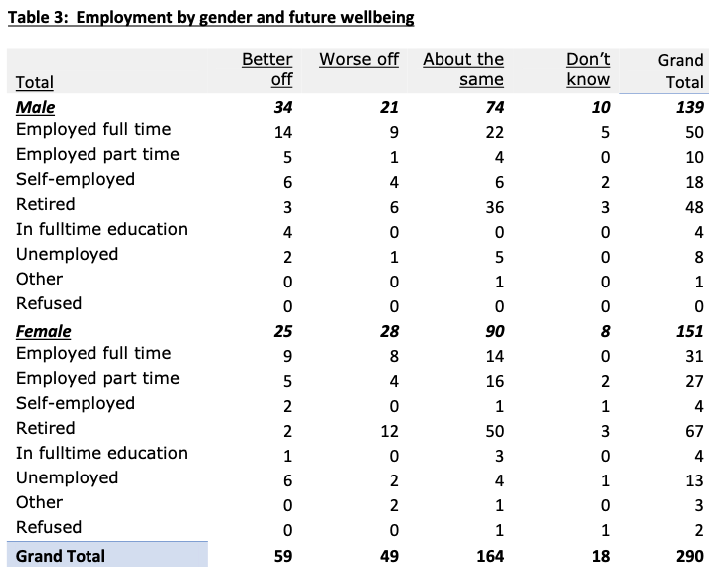
EXAMPLE CMR PROJECT
On the right is an example of how you can expect tabulations in the report to be presented. In this case the table was preceded by the commentary:
"It is of interest to note how the responses to the above 'future wellbeing' question varies by some key classification questions”
and was followed by the comment:
"It is encouraging that the younger respondents are more optimistic...”
This is a small section of a much bigger report, for the full report please click here
The research team for the example on the right is the exact same as the research team forthis Time to Account project.

Slide 5
THE LAST WORD
We want to give you the opportunity to understand your local community to a greater detail and we are interested in what further questions you might have for local businesses.
If you'd like to discuss Time to Account further then please call Tony on +447885088521

